Slide 1
Groups and Teamwork Chapter 6

Slide 2
Chapter Outline
Teams vs. Groups: What’s the Difference?
Why Have Teams Become So Popular?
Types of Teams
From Individual to Team Member
Roles
Norms
Stages of Group and Team Development
The Five-Stage Model
The Punctuated-Equilibrium Model

Slide 3
Chapter Outline
Creating Effective Teams
Context
Composition
Work Design
Process
Beware! Teams Aren’t Always the Answer

Slide 4
Learning Outcomes
What are teams and groups?
How does one become a team player?
Do teams go through stages while they work?
How do we create effective teams?
Are teams always the answer?

Slide 5
Teams vs. Groups: What’s the Difference? the Difference?
Groups
Two or more people with a common relationship.
Teams
A small number of people with complementary skills who are committed to a common purpose, performance goals, and approach for which they hold themselves mutually accountable.

Slide 6
Why Have Teams Become So Popular?
It’s a better way to use employee talents
Teams are more flexible and responsive to changing events
Teams have the capability to quickly assembly, deploy, refocus, and disband.

Slide 7
Types of Teams
Problem-Solving (Process-Improvement) Teams
Groups of 5 to 12 employees from the same department
Meet for a few hours each week to discuss ways of improving quality, efficiency, and the work environment.
Self-Managed (Self-Directed) Teams
Groups of 10 to 15 people
Take on responsibilities of their former managers
Planning, scheduling work, assigning tasks, taking action on problems etc.

Slide 8
Types of Teams
Cross-Functional Teams
Employees from about the same hierarchical level, but from different work areas, who come together to accomplish a task.
Task force: temporary cross functional team
Committee: group composed of members from different departments (more long term in nature)
Skunkworks: cross-functional teams that develop spontaneously to create new products or work on complex problems.
Virtual Teams
Use computer technology to tie together physically dispersed members in order to achieve a common goal.

Slide 9
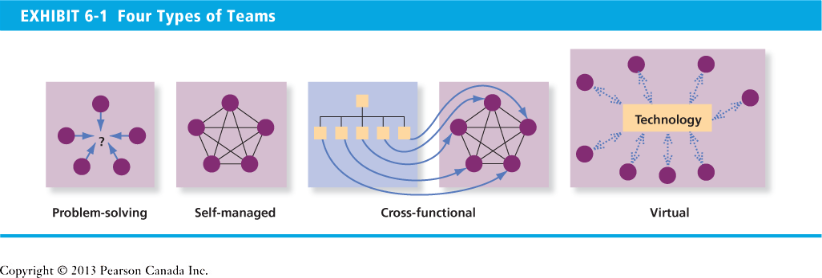
Four Types of Teams

Slide 10
From Individual To Team Member - Roles
Roles
a set of expected behaviour patterns associated with someone occupying a given position in a social unit.
Role Expectations
How others believe a person should act in a given situation.
Role Conflict
A situation in which an individual is confronted by divergent role expectations.

Slide 11
From Individual To Team Member - Roles
Role Ambiguity
A person is unclear about his or her role.
Role Overload
Too much is expected of someone.
Role Underload
Too little is expected of someone
That person feels that they are not contributing

Slide 12
From Individual To Team Member - Norms
Norms
Acceptable standards of behaviour within a group that are shared by the group’s members.
What Norms Cover
Performance: work ethic, work quality, levels of tardiness
Appearance: personal dress, when to look busy, when to "goof off," how to show loyalty
Social arrangement: how team members interact
Allocation of resources: pay, assignments, tools & equipment

Slide 13
How Norms Develop
Explicit statements made by a group member
Critical events in the groups history
Primacy: initial patterns of behaviour
Carry-over behaviour from past situations

Slide 14
Why Norms Are Enforced
Facilitates group’s survival.
Makes behaviour predictable.
Minimizes embarrassment.
Expresses central values and clarifies the group’s identity.

Slide 15
Stages of Group and Team Development
Stage I: Forming
Characterized by uncertainty and anxiety
Stage II: Storming
Characterized by intra-group conflict
Stage III: Norming
Characterized by close relationships and cohesiveness
Stage IV: Performing
The stage when the group is fully functional
Stage V: Adjourning
The final stage in group development
Characterized by concern with wrapping up activities rather than task performance for temporary groups

Slide 16
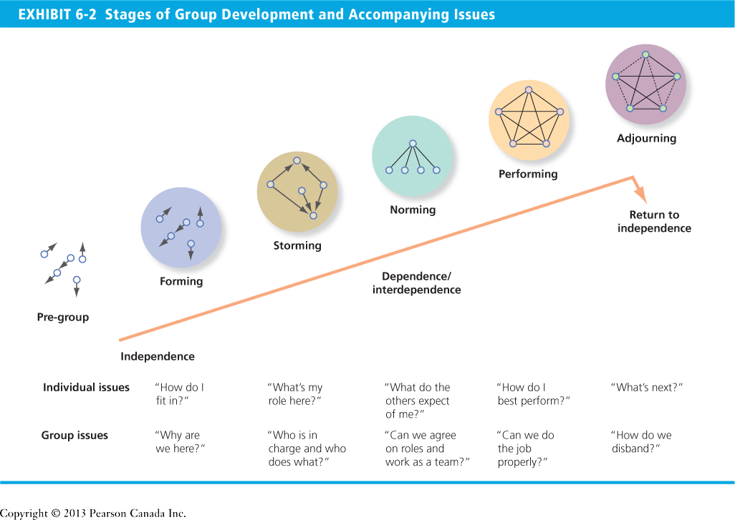

Slide 17
The Punctuated-Equilibrium Model
Phase 1
The first meeting sets the group’s direction.
The first phase of group activity is one of inertia.
Transition
A transition takes place at the end of the first phase, which occurs exactly when the group has used up half its allotted time.
The transition initiates major changes.
Phase 2
A second phase of inertia follows the transition.
Last meeting is characterized by markedly accelerated activity.

Slide 18
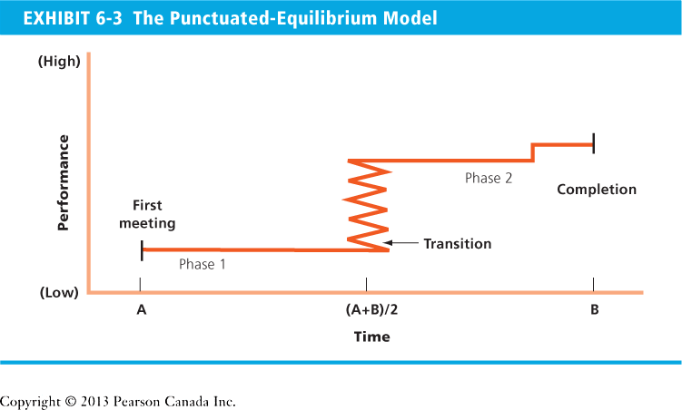
Characteristics of an Effective Team

Slide 19
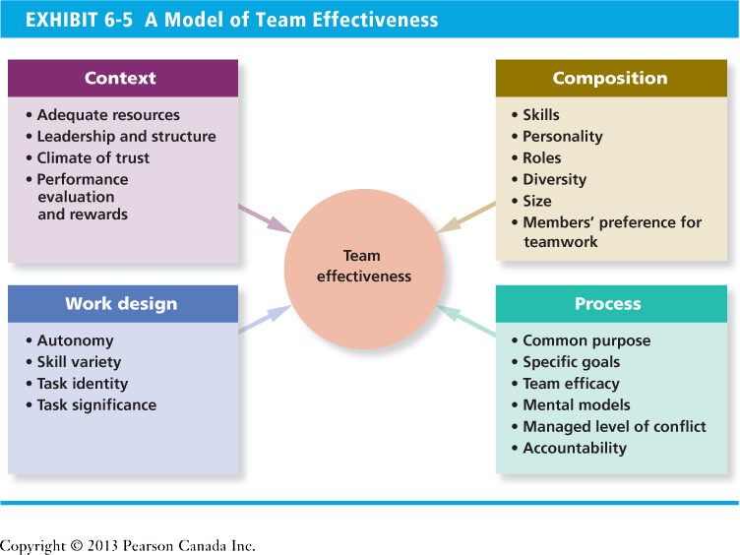
Characteristics of an Effective Team

Slide 20
Characteristics of an Effective Team
Clear purpose
Informality
Participation
Listening
Civilized disagreement
Consensus de
Open communication
Clear rules and work assignments
Shared leadership
External relations
Style diversity
Self-assessment

Slide 21
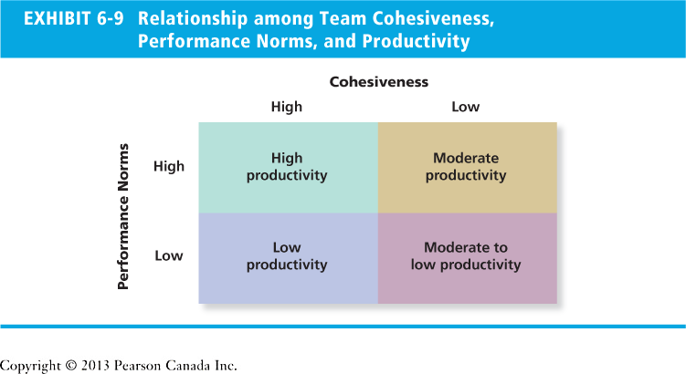

Slide 22
Beware! Teams Aren’t Always the Answer
Teams work best when the answer is yes:
Can the work be done better by more than one person?
Does work create a common purpose or set of goals for the people in the group that is more than the sum of individual goals?
Are members of the group interdependent?
Notes:
Material pertinent to this discussion is found under “Beware! Teams Aren’t Always the Answer.”

